Slide 1

Spark Debugger
Leveraging computation structure for debugging datacenter applications
Murphy McCauley, Matei Zaharia, Tathagata Das, Scott Shenker, Ion Stoica
Motivation
Spark Studio
Debugging distributed datacenter applications is hard and slow, especially for non-experts
In addition to logical correctness, performance is important
Hard to judge expected performance as multi-stage parallel computation on large clusters can have non-intuitive behavior
Hard to analyze actual performance due to insufficient feedback of application execution
Existing debuggers use logging, but have high overhead
Spark makes writing applications fast and intuitive. Can it make debugging fast?
A browser-based Integrated Debugging Environment, that lets non-experts to edit/compile/debug Spark applications on the datacenter.
Visualize
Visually interact with the lineage graph of the generated RDDs
RDD View
…
Dependency View
…
Replay
Reconstruct a specific RDD by partial execution of tasks using the lineage
Debug
Interactively inspect reconstructed RDDs and logs distributed across the cluster
Screenshots
Future Plans
Performance profiling
Execution profiles
Memory usage profiles
More detailed visualizations
Node-specific task schedule view
System status
Higher level counters like number of garbage collections
Suggestions from Spark users
You tell us!
Approach
Leverage inherent structure of the computation in Spark-based applications
Independent units of work with no shared mutable state between them
Lineage of coarse-grained operations make program state re-constructible, fully as well as partially

Slide 2
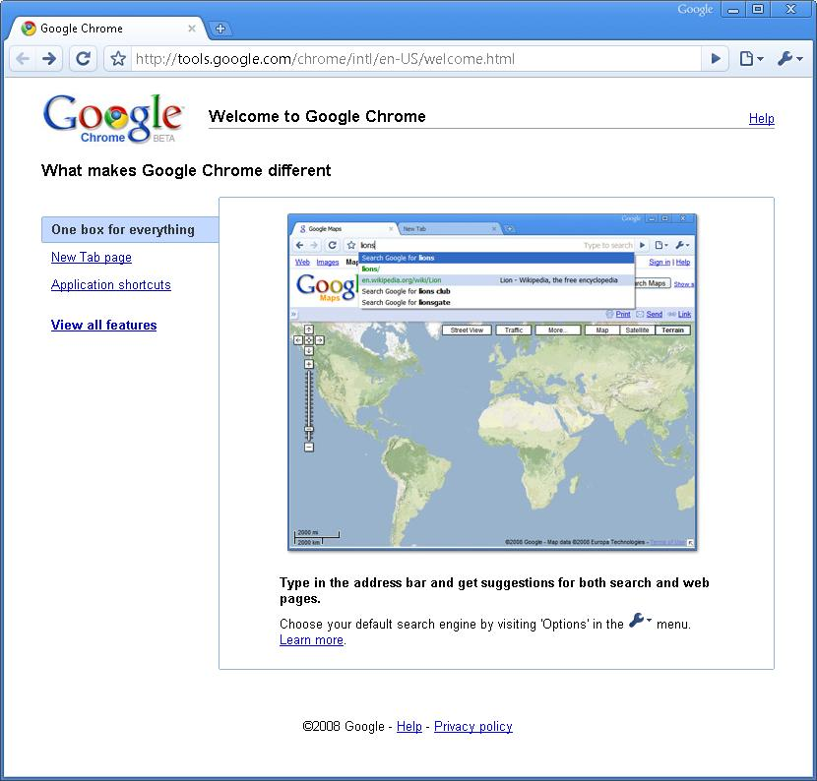
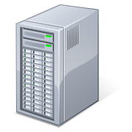
Spark Debugger
Leveraging computation structure for debugging datacenter applications
Murphy McCauley, Matei Zaharia, Tathagata Das, Scott Shenker, Ion Stoica
Motivation
Spark Studio
Debugging distributed datacenter applications is hard and slow, especially for non-experts
In addition to logical correctness, performance is important
Hard to judge expected performance as multi-stage parallel computation on large clusters can have non-intuitive behavior
Hard to analyze actual performance due to insufficient feedback of application execution
Existing debuggers use logging, but have high overhead
Spark makes writing applications fast and intuitive. Can it make debugging fast?
A light-weight browser-based integrated debugging environment
Non-expert users can edit, debug, and visualize Spark applications on the cluster
Specifically, it allows the user to …
Visualize the lineage graph of generated RDDs
Reconstruct a specific RDD and interactively run queries on it
Analyze logs distributed across the cluster
RDD Graph
Code
RDD
// Cache an RDD containing all the
// lines with “ERROR” in a log file
file = spark.textFile("hdfs://...”)
errs = file.filter(_.contains("ERROR"))
cachedErrs = errs.cache()
// Count errors using the cached RDD
ones = cachedErrs.map(_ => 1)
count = ones.reduce(_+_)
filter(_.contains(...))
Filtered RDD
cache()
Logs
Cached RDD
map( _ => 1 )
Mapped RDD
Debug Hub
Spark Shell
_{Master Node}
Logs
Logs
Logs
_{Worker} _{Nodes}
Screenshots
Future Plans
Performance profiling
Execution time profiles
Memory usage profiles
More visualizations
Node-specific task schedule view
Data visualizations
System status
Higher level counters like number of garbage collections
Suggestions from Spark users,
you tell us!
Approach
Leverage inherent structure of the computation in Spark-based applications
Independent units of work with no shared mutable state between them
Lineage of operations make program state re-constructible, with minimal logging overhead

